Slide 1
Service Fabric Hackathon

Slide 2
Outline
Introductions
Overview | Walkthrough of the goals
Installations | VS.NET, Powershell, Service fabric SDK
Service Fabric | Create local SF agent app in vs.net Create local cluster Run locally
Deploy | Deploy app to azure with portal
CI | Create TS project Add code to TS Configure automatic build
Azure config – build with portal | Resource groups Key vault AD
CD | Create deploy task Update and auto deploy
Automate | Create cluster with PS / ARM

Slide 3
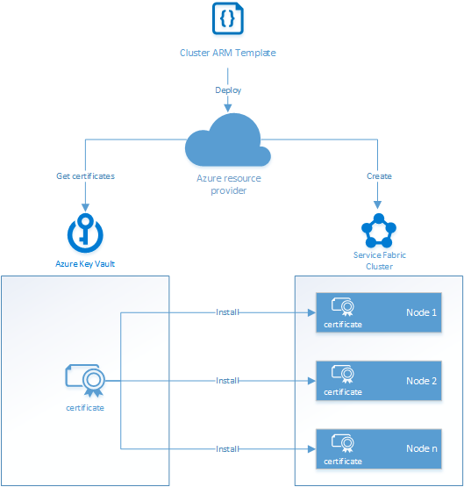

Slide 4
References
 | https://docs.microsoft.com/en-us/azure/service-fabric/service-fabric-cluster-creation-for-windows-server
Setup CI | https://docs.microsoft.com/en-us/azure/service-fabric/service-fabric-set-up-continuous-integration
Create via ARM | https://docs.microsoft.com/en-us/azure/service-fabric/service-fabric-cluster-creation-via-arm
Secure 5 Node ARM | https://github.com/Azure/azure-quickstart-templates/tree/master/service-fabric-secure-cluster-5-node-1-nodetype
Service Fabric in azure | https://opbuildstorageprod.blob.core.windows.net/output-pdf-files/en-us/Azure.azure-documents/live/service-fabric.pdf
Service Fabric SDK | http://www.microsoft.com/web/handlers/webpi.ashx?command=getinstallerredirect&appid=MicrosoftAzure-ServiceFabric-CoreSDK
Capacity Planning | https://docs.microsoft.com/en-us/azure/service-fabric/service-fabric-cluster-capacity
Deploy / manage local cluster | https://github.com/Microsoft/azure-docs/blob/master/articles/service-fabric/service-fabric-get-started-with-a-local-cluster.md
Create Service Fabric Cluster with Portal | https://github.com/Microsoft/azure-docs/blob/master/articles/service-fabric/service-fabric-cluster-creation-via-portal.md
Upgrades | https://github.com/Microsoft/azure-docs/blob/master/articles/service-fabric/service-fabric-application-upgrade.md
CI/CD | https://docs.microsoft.com/en-us/azure/service-fabric/service-fabric-set-up-continuous-integration https://github.com/Microsoft/azure-docs/blob/master/articles/service-fabric/service-fabric-set-up-continuous-integration.md

Slide 5
Useful Scripts / Extensions
SDK Cluster Setup | https://github.com/Microsoft/azure-docs/blob/master/articles/service-fabric/service-fabric-get-started-with-a-local-cluster.md
Dev Cluster Setup | & "$ENV:ProgramFiles\Microsoft SDKs\Service Fabric\ClusterSetup\DevClusterSetup.ps1" -CreateOneNodeCluster

Slide 6
Useful powershell commands
Connect-ServiceFabricCluster
Publish-NewServiceFabricApplication
Get-ServiceFabricApplication
Get-ServiceFabricService
Get-ServiceFabricPartition
Publish-UpgradedServiceFabricApplication
Unpublish-ServiceFabricApplication
Remove-ServiceFabricApplicationType

Slide 7
Deploy application

Slide 8
Upgrade Application
Publish-UpgradedServiceFabricApplication

Slide 9
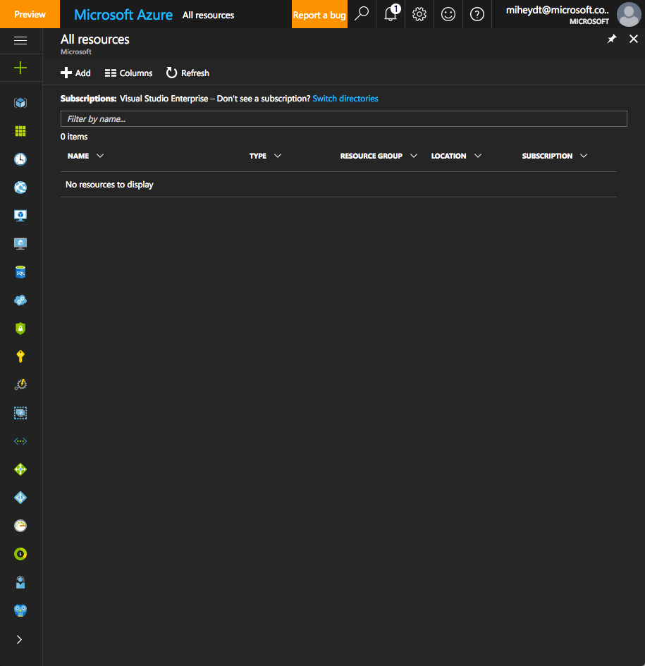

Slide 10
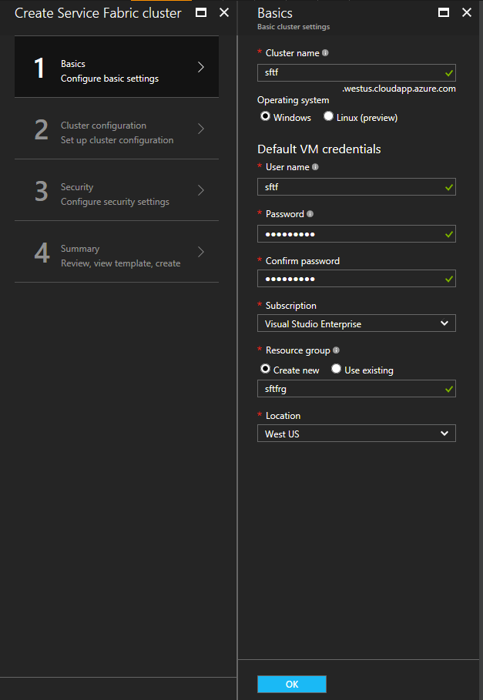

Slide 11
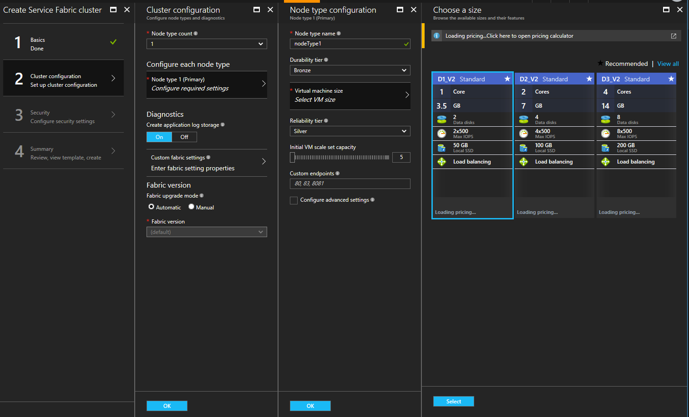

Slide 12
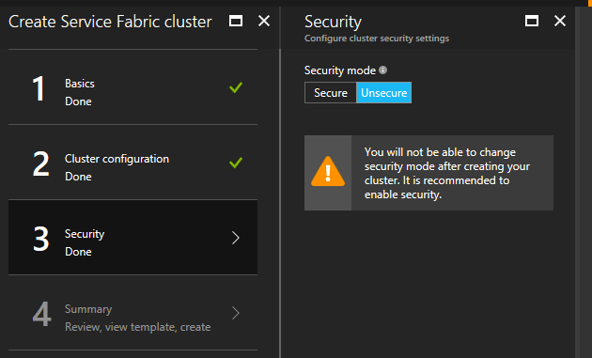

Slide 13
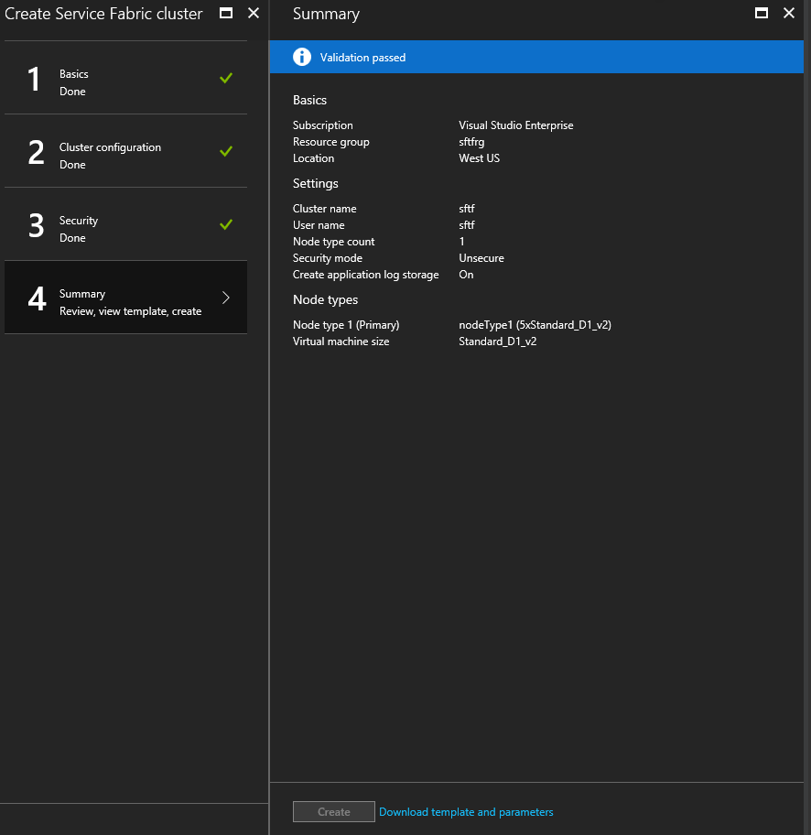

Slide 14
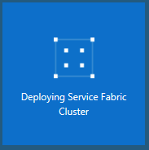

Slide 15
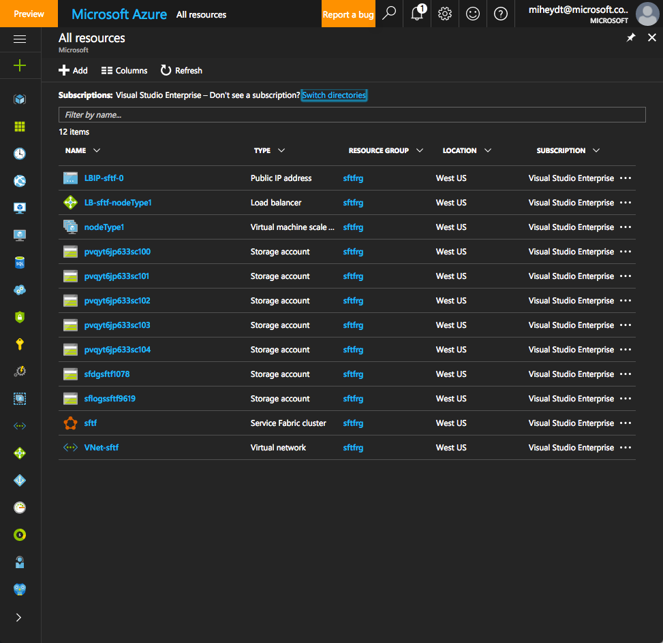

Slide 16
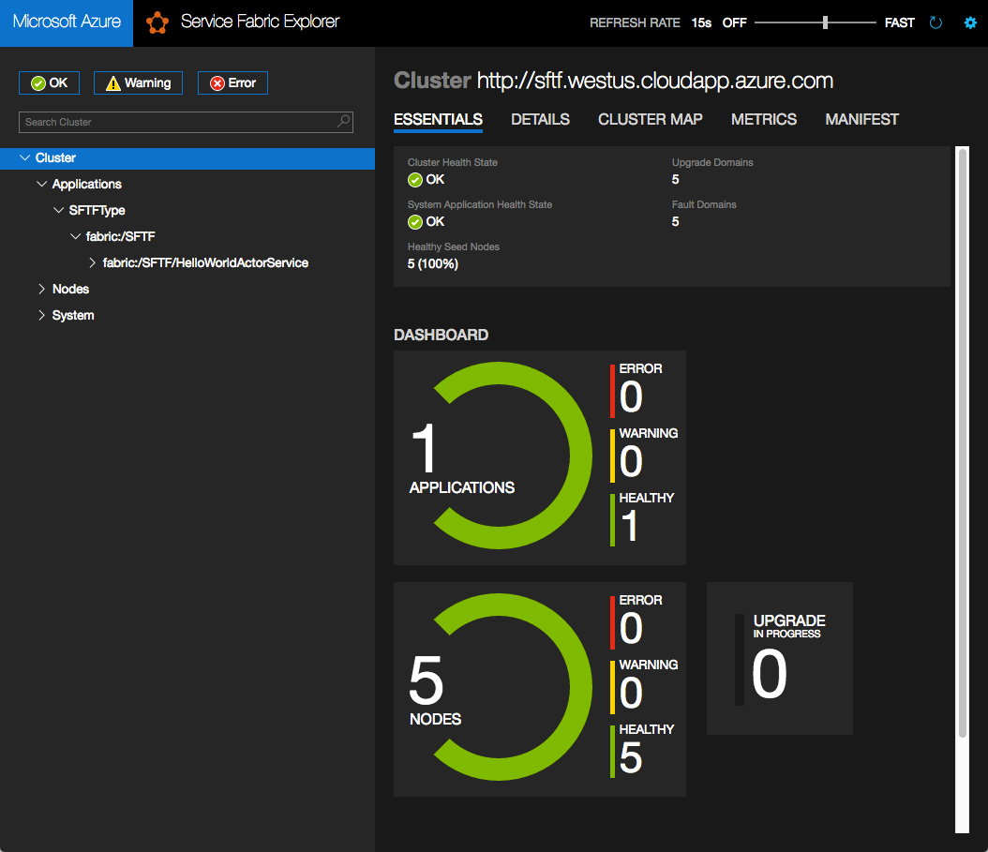

Slide 17
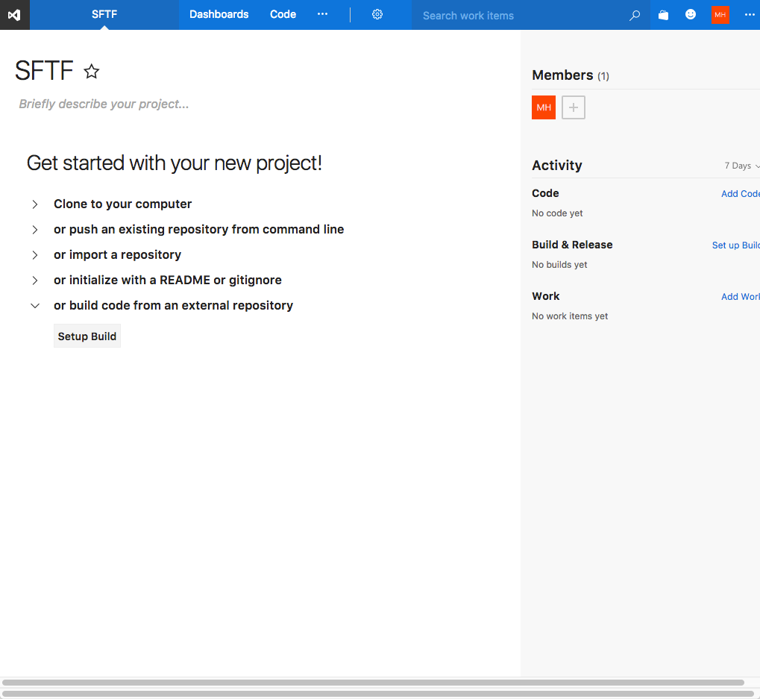

Slide 18
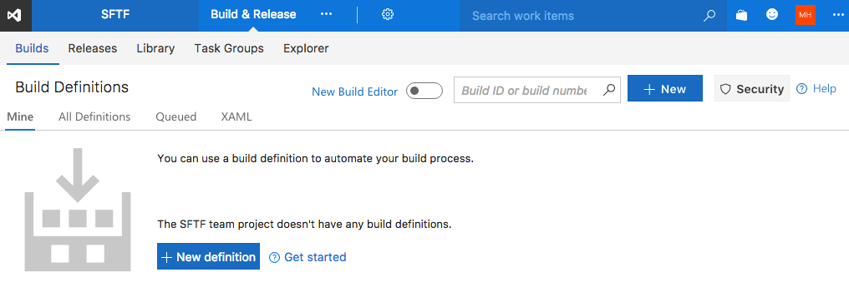

Slide 19
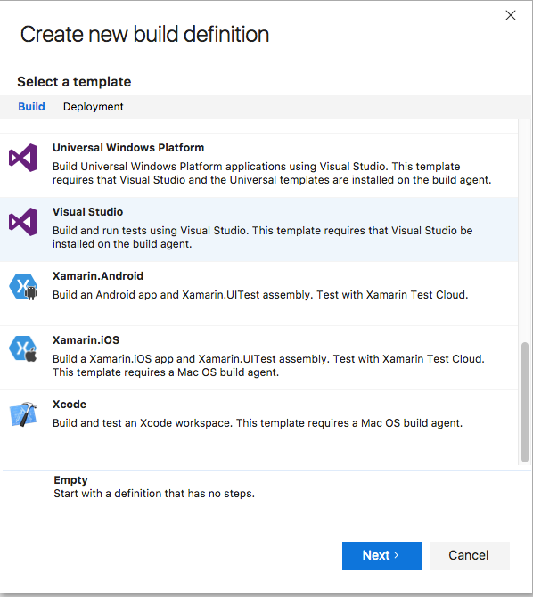

Slide 20
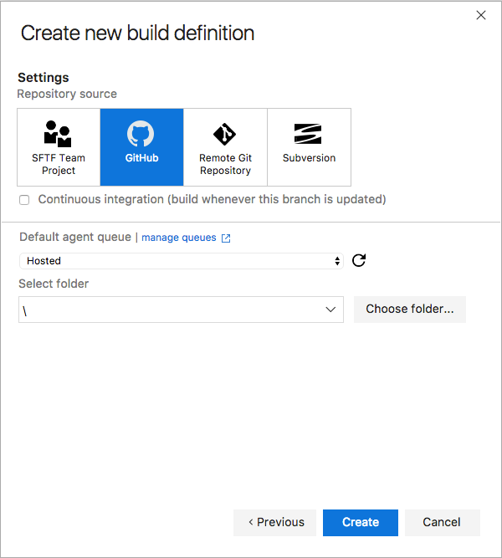

Slide 22
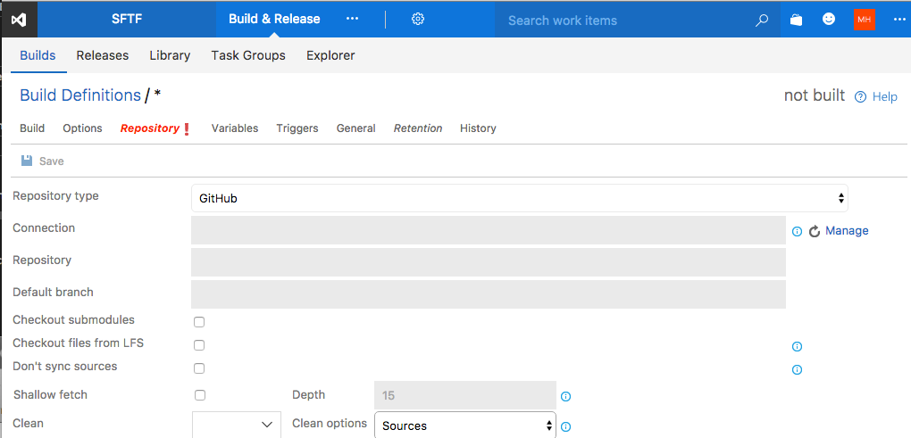

Slide 23
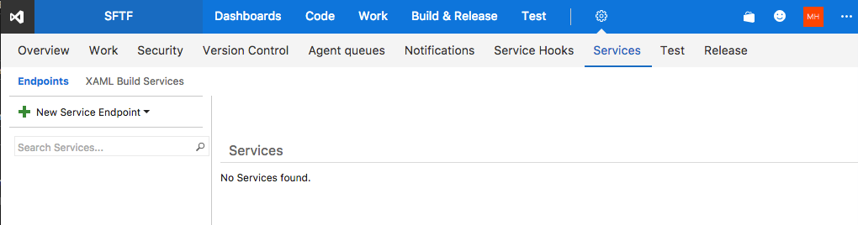

Slide 24
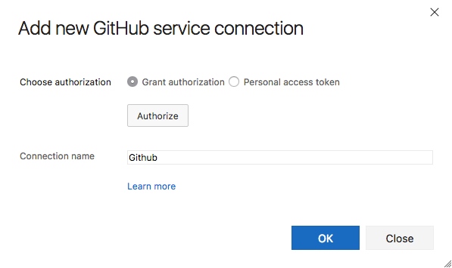

Slide 25
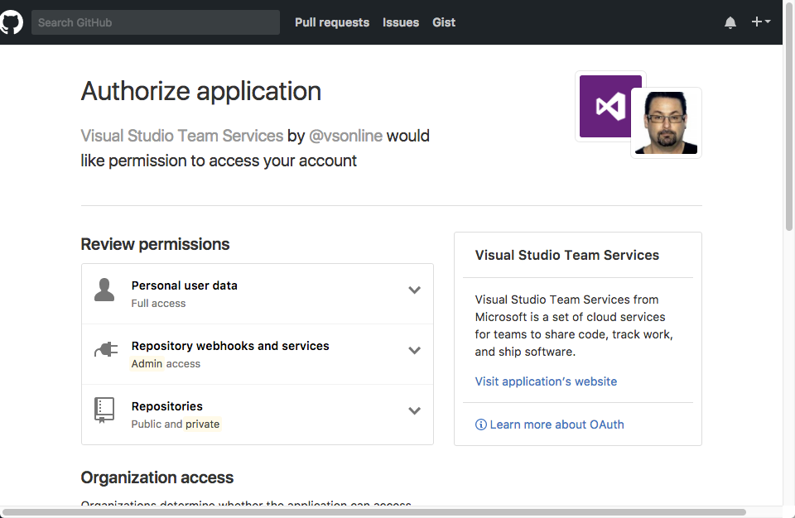

Slide 26
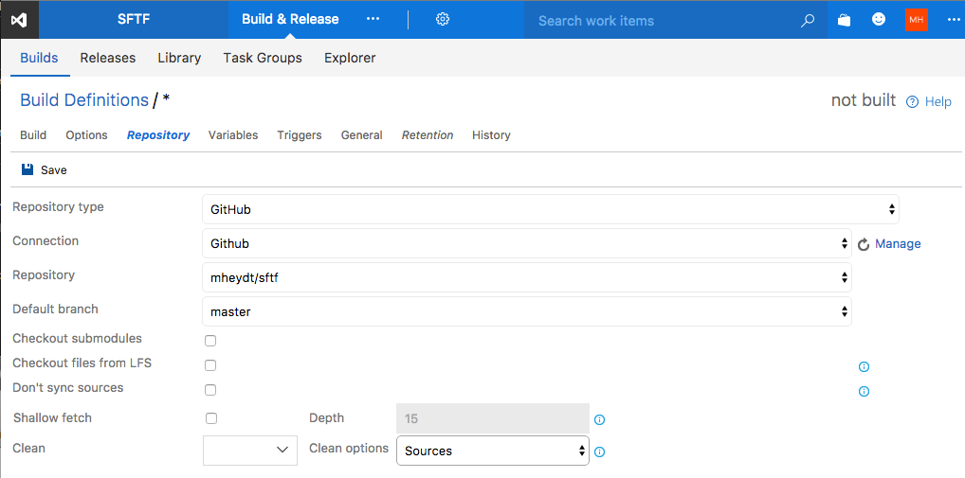

Slide 27
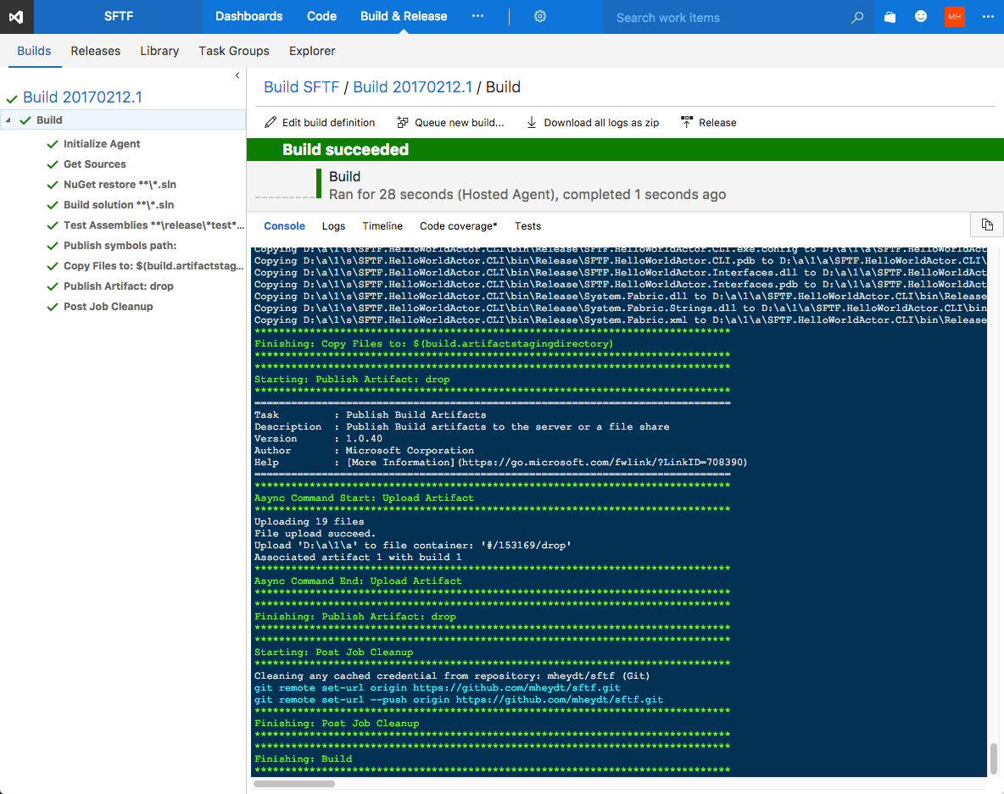

Slide 28
